Slide 1
Analysis of Accidental Drug Deaths in Connecticut 2012-2018
Loretta Cortez
Prerak Patel
Daniel Santa
Kensuke Suzuki

Slide 2
Summary
Analyzing drug related deaths in Connecticut between 2012-2018 to identify responsible factors and draw conclusions that could help increase public awareness and enable responsible agencies to take preventive actions.

Slide 3
Questions
Are accidental drug related deaths increasing year over year?
Is there a seasonal impact on drug related deaths?
Does age, gender, and race have any impact on these deaths?
Are there particular drugs impacting these deaths?
Notes:
Kensuke

Slide 4
Data Cleanup
Source
Data.gov
Cleanup
NaN values.
Data type of date fields.
Missing values for age, sex and race columns.
Remove columns non relevant for analysis.
Notes:
Describe the exploration and cleanup process
Discuss insights you had while exploring the data that you didn't anticipate
Discuss any problems that arose after exploring the data, and how you resolved them.
Present and discuss interesting figures developed during exploration, ideally with the help of Jupyter Notebook

Slide 5
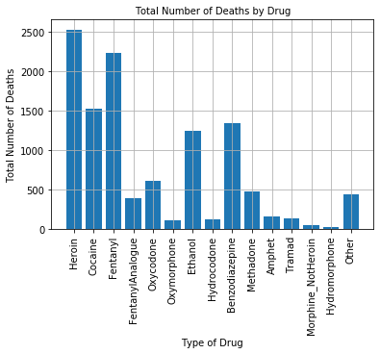
Top 3 Drugs Contributing to Accidental Death
According to the data, the top three drugs that caused accidental death are:
Heroin
Fentanyl
Cocaine
Notes:
Kensuke

Slide 6
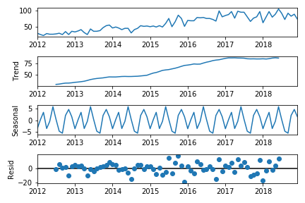
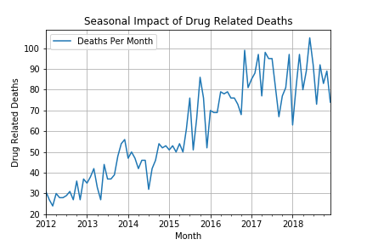
Drug Related Deaths - Seasonal Impact
Mortality rate increased year over year.
Mortality higher during winter/holiday season.
Notes:
Observed: The average value in the series.
Trend: The increasing or decreasing value in the series.
Seasonality: The repeating short-term cycle in the series.
Residual: The random variation in the series. - Positive outliers increasing

Slide 7
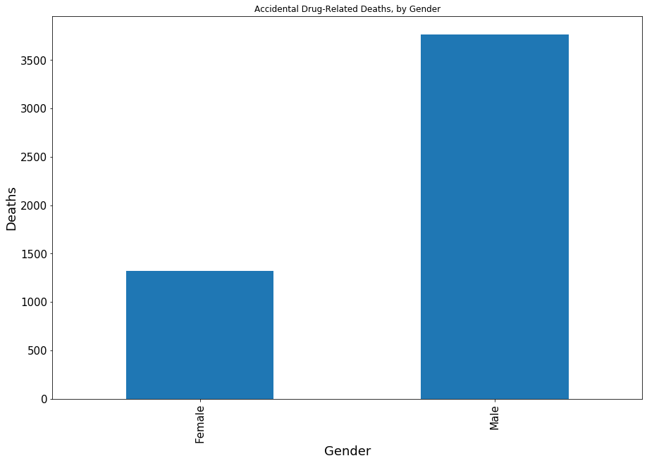
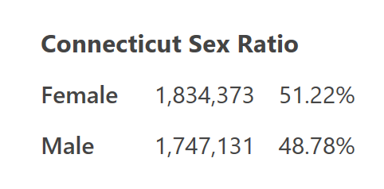
Accidental Drug-Related Deaths - Gender
Females deaths 26%
Male deaths - 74%
Notes:
https://worldpopulationreview.com/states/connecticut-population/

Slide 8
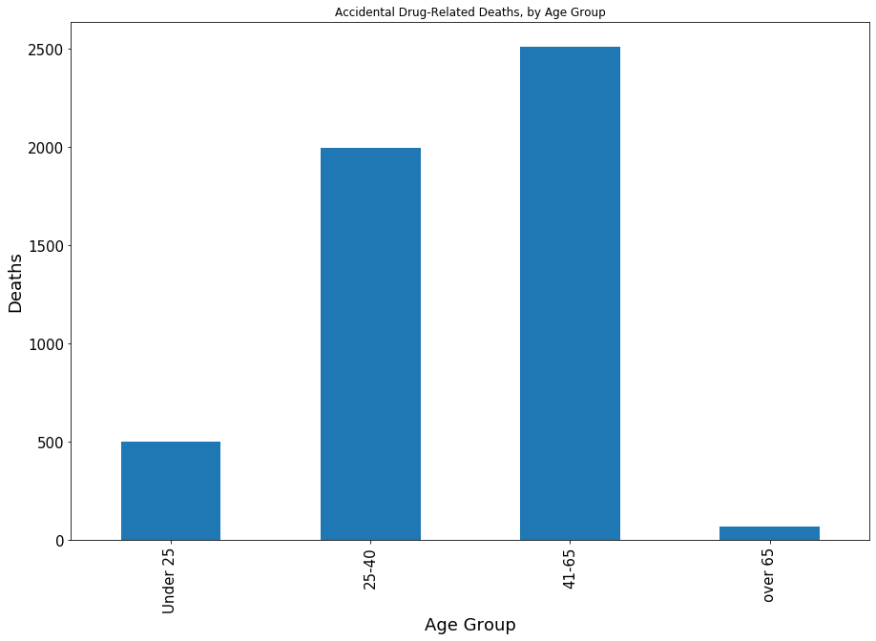
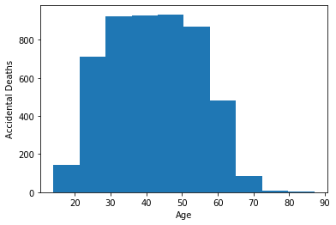
Accidental Drug-Related Deaths - Age Group
Mean age is 42
Mean age in data set is 42

Slide 9
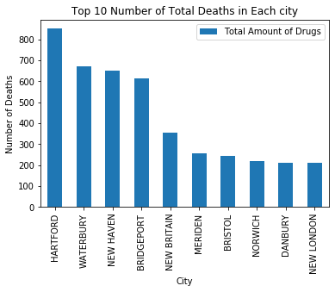
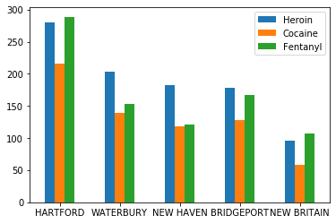
Drugs Related Deaths by City
According to the data found, we were able to find that the highest mortality were found in Hartford, Waterbury, and New Haven. We also found that both Heroin and Cocaine had a similar distribution impact in the top cities.
Notes:
Emphasize significance of Heroine,Cocaine, and Fentanyl.

Slide 10
Final Results
According to our Analysis, to stem accidental drug deaths, we should concentrate on outreach to this demographic:
White*
Male
Aged 41- 65
Lives in Hartford
Finally, we should concentrate outreach around the Holiday Season.
*Based on analysis not presented
Notes:
Powerbi & tableau
Death rate by race showed 78% of deaths related to White race. Check of the population distribution with US Census Bureau showed 80% White population, so death rate appears to follow the same distribution pattern as overall population.

